Slide 1
Razor Blade Witness
Peter Rose
Krich Group
April 12, 2017

Slide 2
Outline
We present a new witness protocol, robust to some non-Condon effects
Pulse shapes and parameters
Define system parameters
Witness protocol and preliminary results
Additional technical details
What still needs to be done

Slide 3
Outline
We present a new witness protocol, robust to some non-Condon effects
Pulse shapes and parameters
Define system parameters
Witness protocol and preliminary results
Additional technical details
What still needs to be done

Slide 4
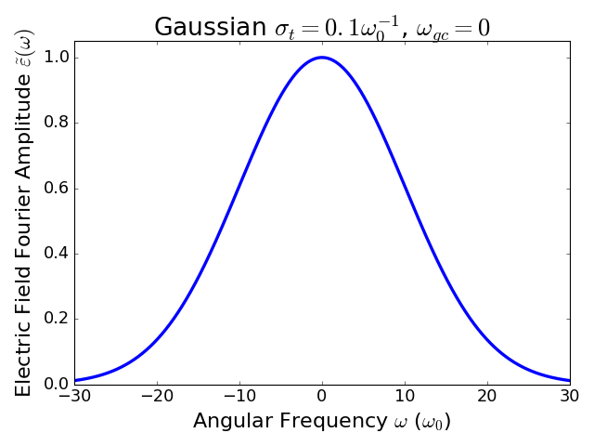
Start with a Bare Gaussian in Frequency Domain
(Zero frequency means resonant with the 0-0 ground state to excited state transition)

Slide 5

Electric Field in Frequency Domain with Razor Blades
Razor Blade
Width
σ_{rb}
Gaussian Center
ω_{gc}
Razor Blade Center
ω_{rc}

Slide 6
Electric Field Parameters
Pulse is characterized by 4 parameters
Razor blade width – σ_{rb} (in frequency)
Razor blade center - ω_{rc} (in frequency)
Gaussian sigma – σ_{t} (in time)
Gaussian center - ω_{gc} (in frequency)
For now we set ω_{gc} = 0, i.e. to the 0-0 transition from the ground to the electronic excited state.

Slide 7
Outline
Pulse shapes and parameters
Define system parameters
Witness protocol and preliminary results
Additional technical details
What still needs to be done

Slide 8
Monomer (no coherence)
1 electronic excitation, 1 harmonic vibrational mode
Huang Rhys Factor – S
Linear Condon Violation – κ
Defined relative to the condon dipole moment μ₀:
μ(R)=μ₀(1+κR)
R is the displacement from the ground state potential surface minimum
The ground state vibrational frequency – ω_{g} = ω₀
Excited state vibrational frequency – ω_{e} = 0.9ω₀

Slide 9
Dimer (with coherence)
Two singly-excited electronic states, with coupling strength J.
ω_{e} is the separation between excitonic states
No vibrations

Slide 10
Outline
Pulse shapes and parameters
Define system parameters
Witness protocol and preliminary results
Additional technical details
What still needs to be done

Slide 11
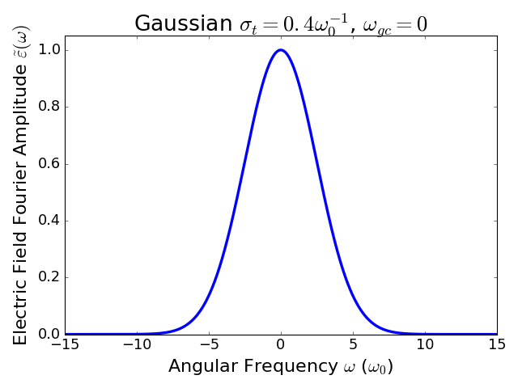
Fix the Gaussian Shape

Slide 12
…And the razor blade width…
σ_{rb} = 10ω₀

Slide 13
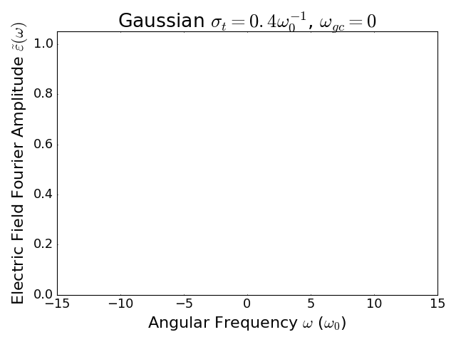
…And vary the razor blade center
σ_{rb} = 10ω₀

Slide 14
Proposed Witness Protocol
Choose pulses with ω_{gc} = 0 and σ_{rb}> σ_{t}⁻¹.
Take pump-probe data S(T) as a function of delay time T for different values of ω_{rc}.
Take the Fourier transform of S(T) and extract the amplitude at ω_{e}* for each value of ω_{rc}.
Plot the Fourier amplitudes as a function of ω_{rc}.
*See slide entitled Additional Material Parameters for a note about this frequency

Slide 15
Example of Protocol
We show calculations for the following parameters:
ω_{gc} = 0
σ_{rb} = 10ω₀
σ_{t} = 0.4ω₀⁻¹
We vary ω_{rc} from -8ω₀ to 8ω₀ in steps of ω₀.
We show calculations for a monomer with one vibrational mode, with several different values of S and κ.
We compare these calculations to a system with electronic coherence at the same response frequency.

Slide 16
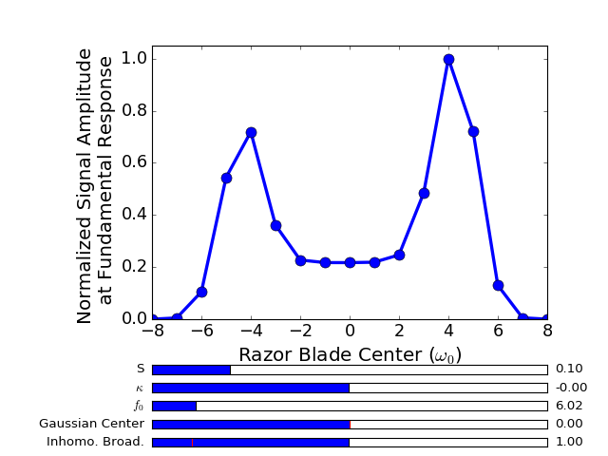
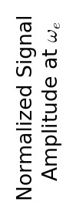
Example of the Negative Witness
Monomer
S = 0.1, κ = 0
Peak
Essence of witness is the peak to trough ratio
Trough

Slide 17
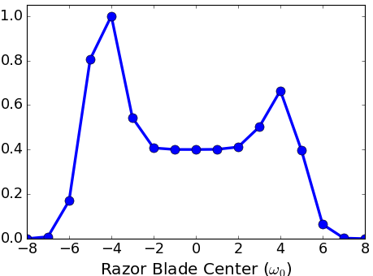
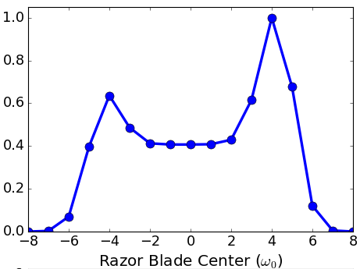
Some other examples
S = 0.1, κ = 0.14
S = 0.1, κ = 0
Peak
Peak
S = 0.1, κ = –0.04
Peak

Slide 18
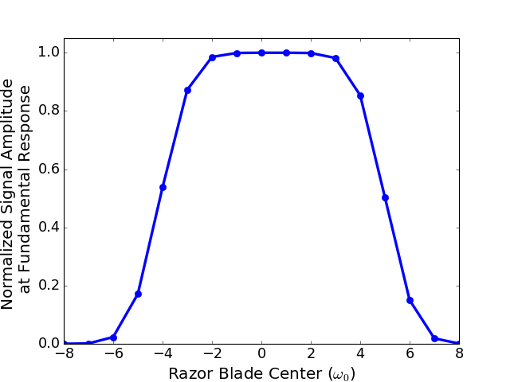
Example of the Positive Witness
Dimer

Slide 19
Key Signature of Witness
Key qualitative difference: negative witness has at least one peak and a trough, whereas positive witness has no trough.
Monomer
Dimer

Slide 20
When does it “work”
At large κ, the witness fails. Our goal is to determine what “large” is.
We consider a working witness protocol to be a case where the trough-to-peak ratio is <0.5.
For parameters (S, κ) where at least one peak exists with a trough-to-peak ratio <0.5, we consider that this is a working witness protocol.

Slide 21
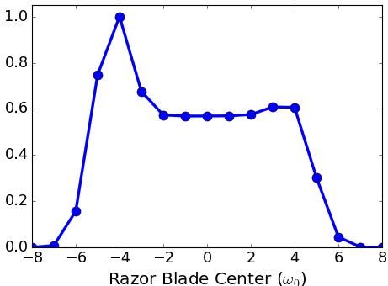
False Positive Witness
Here is an example of (S, κ) where the witness protocol fails.
Monomer
S=0.1, κ=0.18
0.5 Failure Line

Slide 22
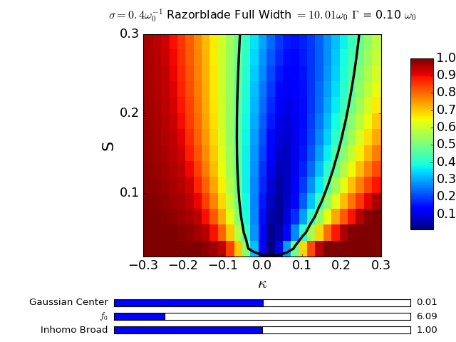
Working Region
This plot shows the trough-to-peak ratio for a variety of values of S and κ.
0.5 Ratio Contour
Trough-to-peak ratio
Witness protocol fails in this region
Witness protocol works in this region

Slide 23
We can do better!
This is promising, because it suggests that there is a reasonable region of S-κ space where this witness protocol will work.
However, it is possible to improve this protocol by repeating the same procedure twice more with ω_{gc} set to –1.5ω₀ and +1.5ω₀.

Slide 24
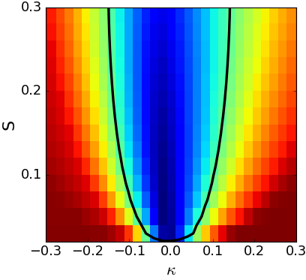
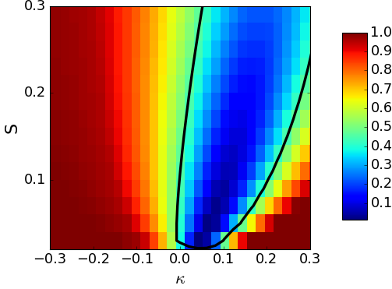
Now change Gaussian center
If we change the Gaussian center, we can access a greater percentage of S-κ space.
A trough-like structure in any one of these experiments is interpreted as a negative witness.
ω_{gc}= -1.5ω₀
ω_{gc}= 0
ω_{gc}= 1.5ω₀

Slide 25
Outline
Pulse shapes and parameters
Define system parameters
Witness protocol and preliminary results
Additional technical details
What still needs to be done

Slide 26
Additional Material Parameters
Fundamental Oscillation Frequency – f₀
In this presentation we set f₀=200cm⁻¹
This is like a temperature knob, since we set the ambient temperature to be 300 Kelvin. For f₀=100cm⁻¹ we must calculate a boltzmann average over the lowest 15 initial ground vibrational states, whereas for f₀=800cm⁻¹ only the 0th mode of the initial ground state need be included.
Homogeneous Linewidth – Γ
This is the decay rate of the oscillatory signal produced by the pump-probe experiment
So far we have only studied Γ=0.1ω₀, which means that the ground state and excited state frequencies cannot be distinguished for the given ratio of ω_{e}/ω_{g} = 0.9
Inhomogeneous Broadening
We assume that the 0->0 transition frequency is actually a Gaussian distribution, so we calculate an incoherent average over 0->0 transition frequencies. As a general rule, as the inhomogeneous broadening increases, the region of the S-κ plane that is accessible using this technique decreases.
In this presentation we set the σ of this Gaussian distribution to be 1ω₀

Slide 27
Spectroscopy Assumptions
We calculate the pump-probe signal assuming that the pump and probe pulses are identical (including in polarization)
All calculations assume that the pump and probe are well-separated in time even with the razor blades. Previous work done in the Condon approximation shows this to be a good assumption, despite the sinc-like quality of the pulses. However, we still need to verify that this holds for a system with a linear Condon violation.

Slide 28
Outline
Pulse shapes and parameters
Define system parameters
Witness protocol and preliminary results
Additional technical details
What still needs to be done

Slide 29
Next Steps
We must verify that these results hold when pump-probe overlap is taken into account.
Peter and Joey have been discussing some analytical work that needs to be completed about the S = 0 limit.
We need to consider a dimer model that includes two vibrational modes

